Slide 1
FAS Project
Nathaniel Gee

Slide 2
Model Selection
Before deciding on my best model, I ran several models to test on the data:
Linear Regression
Simple linear regression using all the predictor variables
Backward and Forward Stepwise Regression
Done to see how a regression model would do with fewer predictors
Lasso Regression:
Believed that not all variables were relevant to the prediction, so I used a Lasso regression as a way of variable selection
Ultimately this is the model that I decide was best for the project
Support Vector Machine Model:
Wanted to see how a nonlinear regression model would perform on the data

Slide 3
Lasso Regression Model
Reasoning:
Believed that data was somewhat linear due to shooting percentage seeming to be correlated. Logically higher corner three-point percentage acquaints to a higher overall three-point percentage
However, some variables such as paint shots did not seem as strong of a predictor, and was reflected in the correlation matrix and later in the feature importance test
Although all variables were used, the Lasso regression penalizes those that are less predictive and as such is a form of feature selection.
Test and Train Samples
Trained a model on 80% of the data and saved 20% for testing the model
Cross Validation:
Used to boost the performance of the model and select the optimal regulation parameter

Slide 4
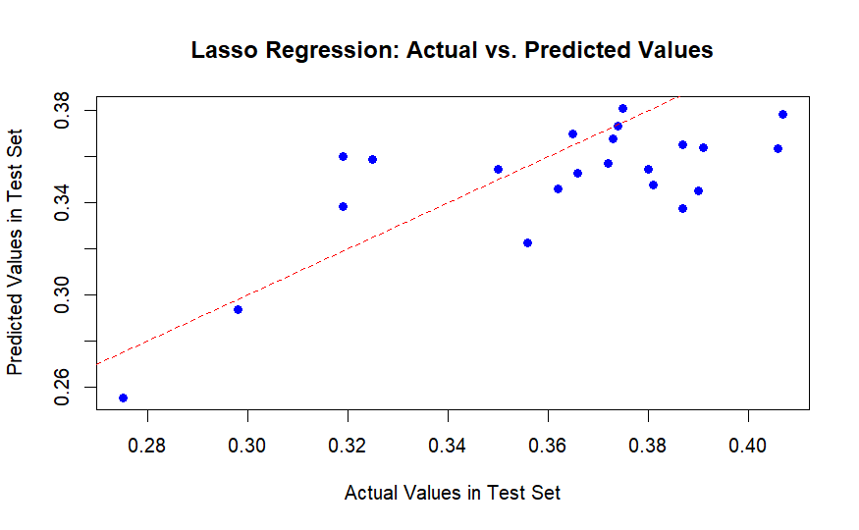
Prediction Accuracy
Model | MSE
Linear Regression | 0.000825
Forward Regression | 0.000786
Backward Regression | 0.000786
Lasso Regression | 0.000144
Support Vector Machine | 0.003267
As a measure of model accuracy, I examined the Mean Squared Error (MSE) on the test set
Out of all the models tested, Lasso had the lowest MSE indicating the predictions were closest to the actual values
Reasoning for MSE as Accuracy Measure:
MSE penalizes larger errors and is a widely used metric
MSE is mathematically easy to compute
and understand for simplicity

